Slide 1
Chapter 09: Public-Key Cryptography And RSA
Freshman Seminar
22.01.21
Sumin Sohn

Slide 2
Contents
9.1 Principles of public-key cryptosystems
9.2 The RSA algorithm

Slide 3
9.1 Principles of public-key cryptosystems

Slide 4
Problems of Symmetric Encryption
Problems
Key distribution under symmetric encryption requires
Two communicants already share a key
Highly depends on the key
Digital signatures
Need to prove a message had been sent by a particular person
Concept of public-key cryptography evolved from these 2 problems
Notes:
- Compromise 될 수 있는 KDC와의 key 공유
- 특정 그 사람한테서 온 메시지가 맞는지에 대한 의심
이 두가지 문제가 대칭 키 암호에서 일어날 수 있고, public key cryptography 등장
9.1에서 다루는 건
1) 전반적인 프레임워크
2) 암호화/복호화 요구사항

Slide 5
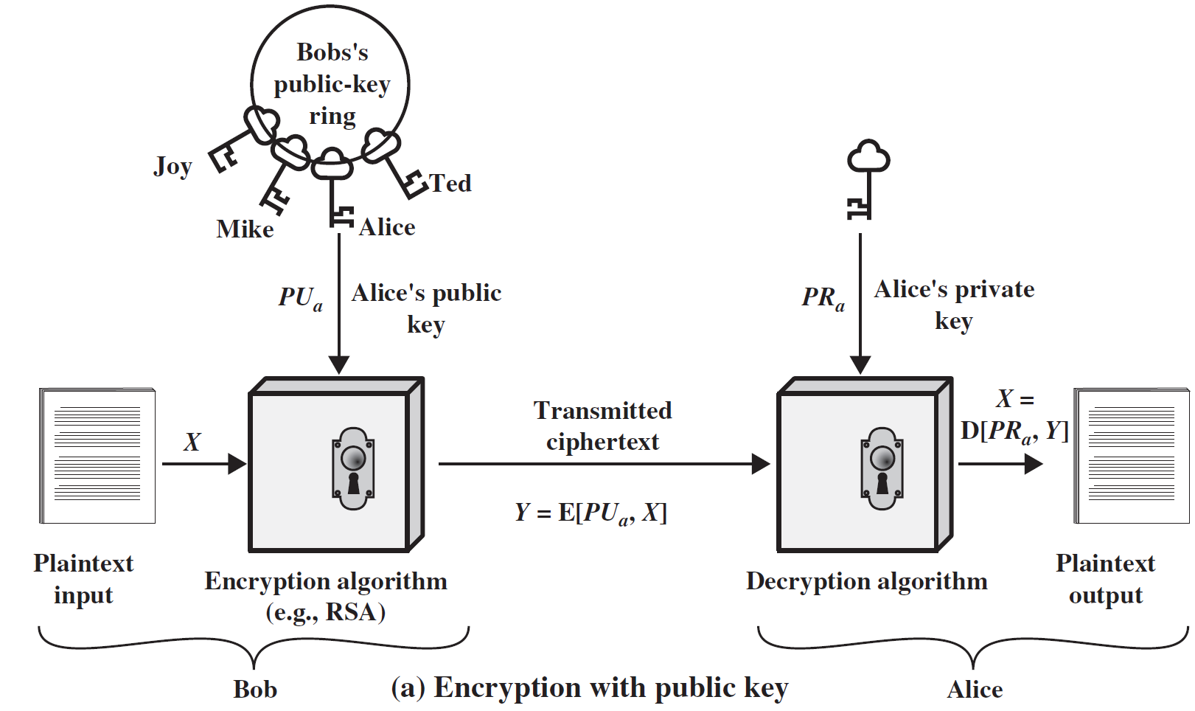
Ingredients of Public-Key Encryption
Plaintext
Readable message or data
Encryption algorithm
Perform transformations of plaintext
Public and private keys
One is used for encryption, the other is used for decryption
Ciphertext
Produces Confidentiality
Decryption algorithm
Produces original plaintext

Slide 6

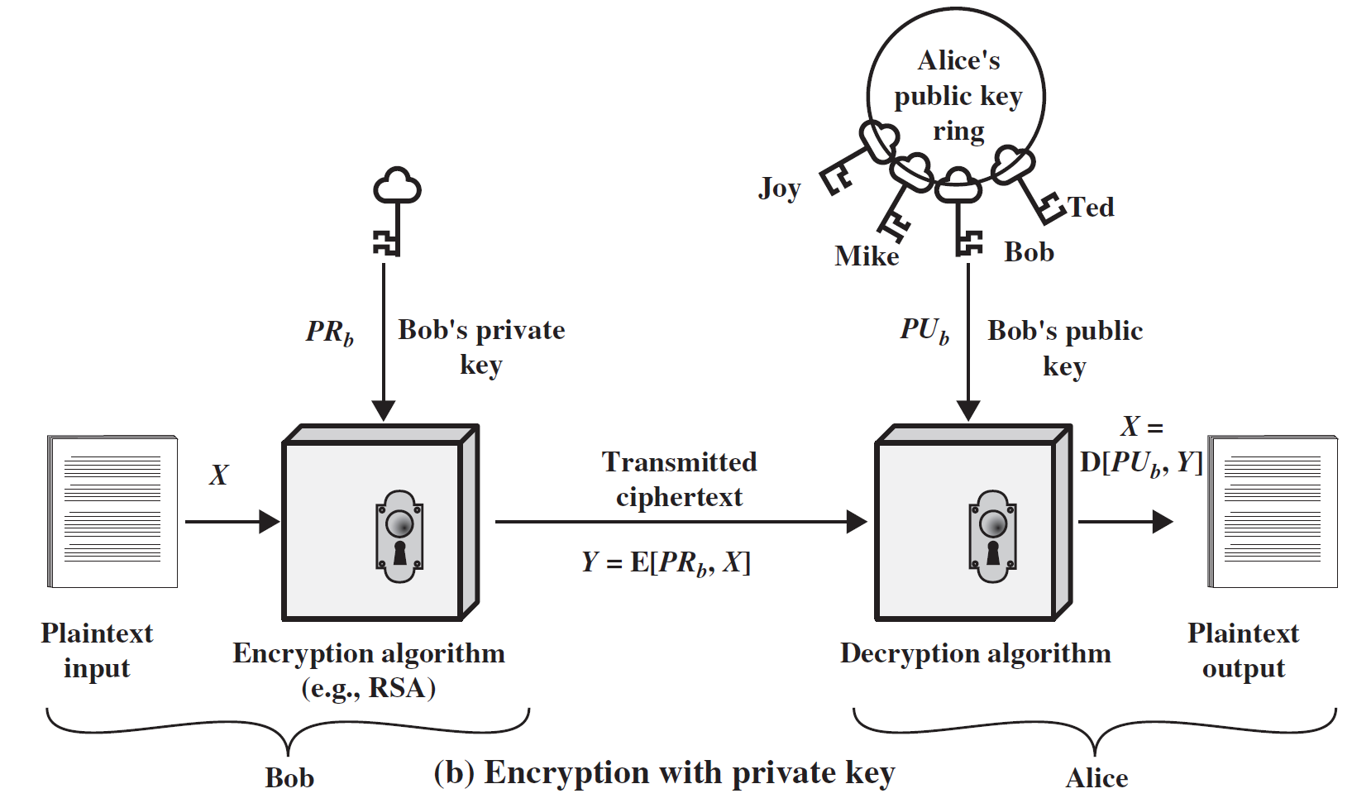
Two Uses of Public-Key Cryptosystem
Provides confidentiality
Provides authentication

Slide 7
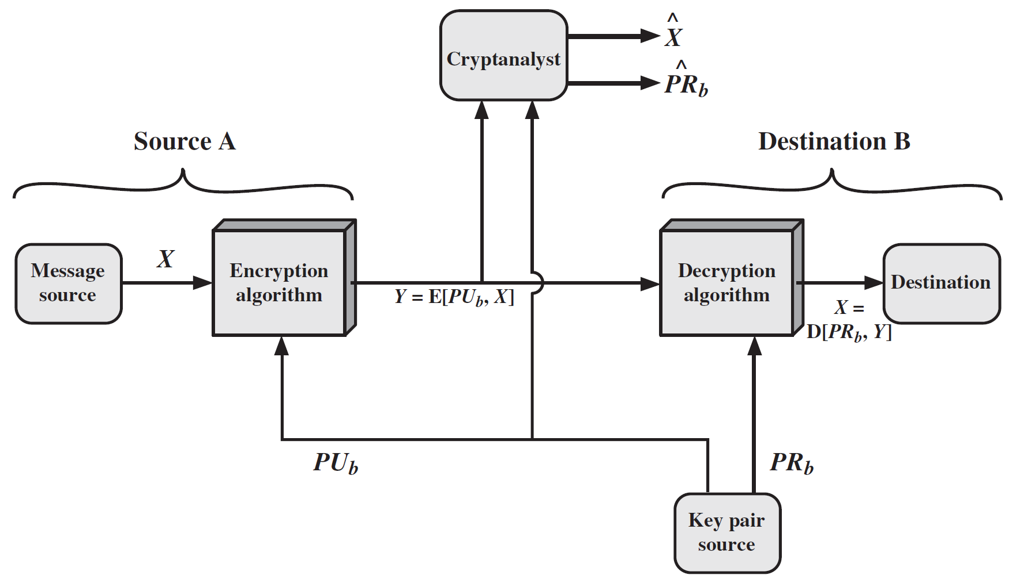
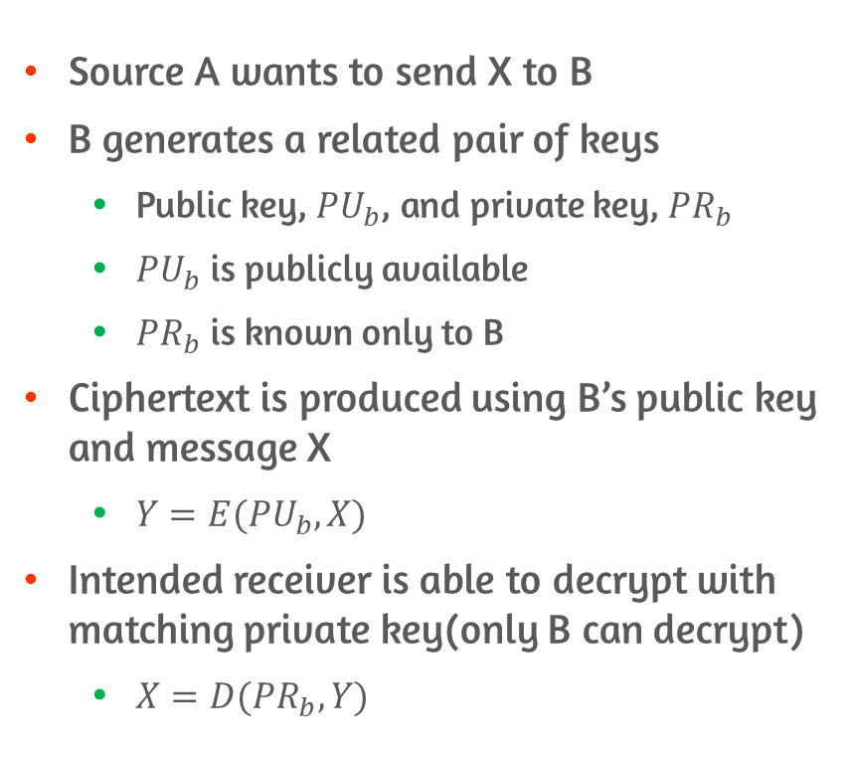
Public-Key Cryptosystem: Secrecy
Source A wants to send X to B
B generates a related pair of keys
Public key, ${PU}_{b}$, and private key, ${PR}_{b}$
${PU}_{b}$ is publicly available
${PR}_{b}$ is known only to B
Ciphertext is produced using B’s public key and message X
$Y=E({PU}_{b}, X)$
Intended receiver is able to decrypt with matching private key(only B can decrypt)
$X=D({PR}_{b}, Y)$
Notes:
공격자 입장에서는 암호문과 B의 공개 키만 알 수 있음
Private key 또는 원래 메시지를 알아내야 함

Slide 8
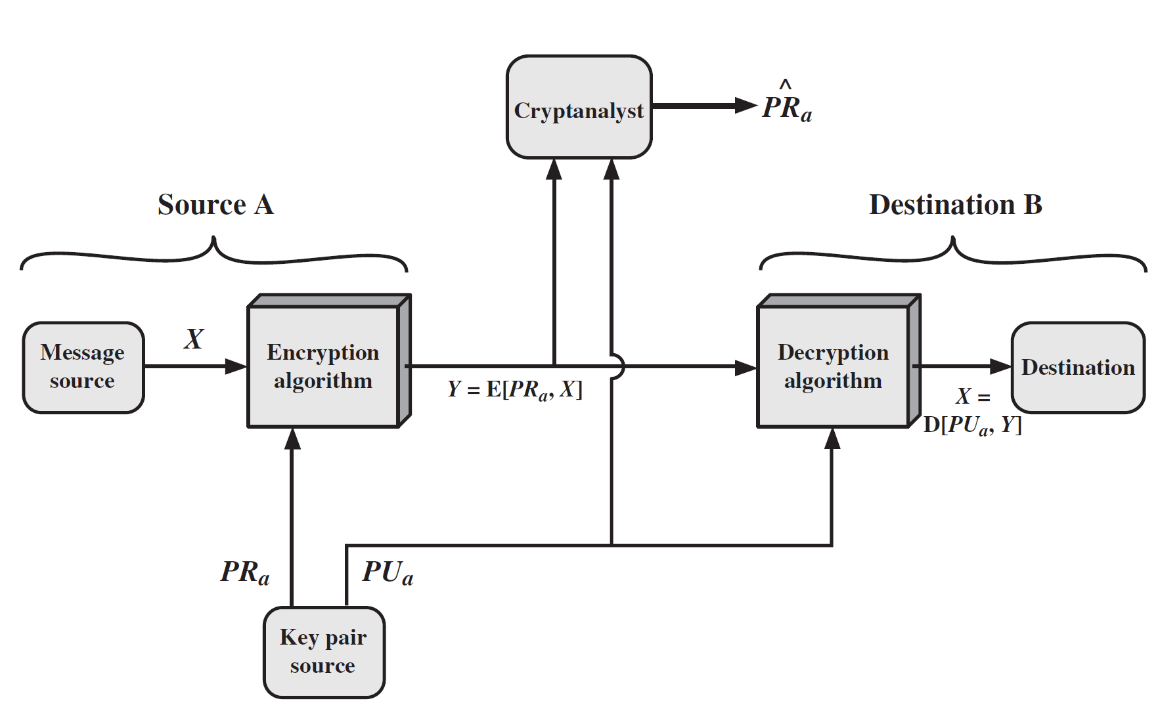
Public-Key Cryptosystem: Authentication
A prepares a message to B
Encrypt using A’s private key
Entire encrypted message serves as a digital signature
B can decrypt the message using A’s public key
Message is authenticated both in terms of source and data integrity
Impossible to alter the message without access to A’s private key

Slide 9
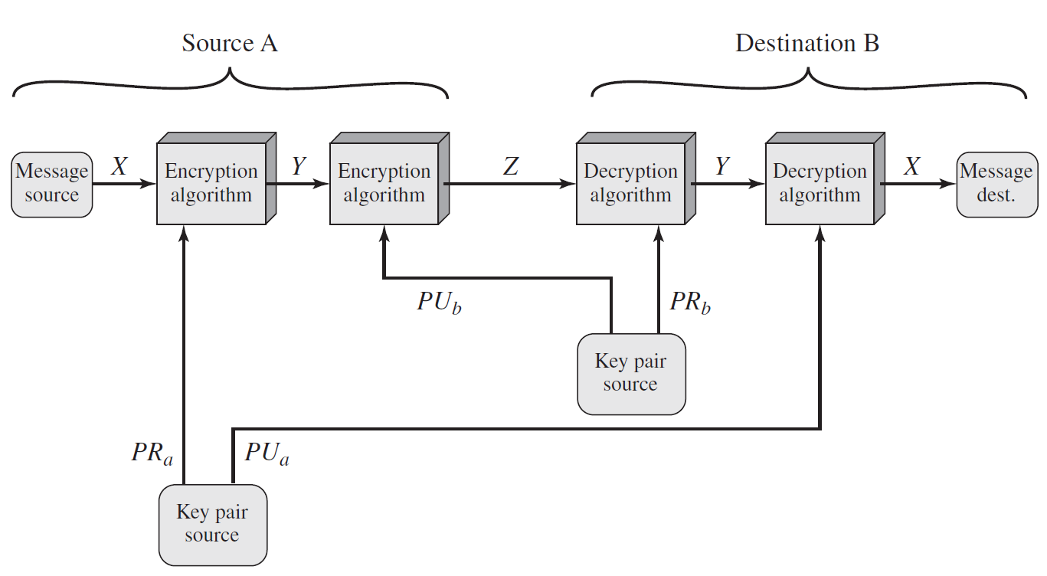
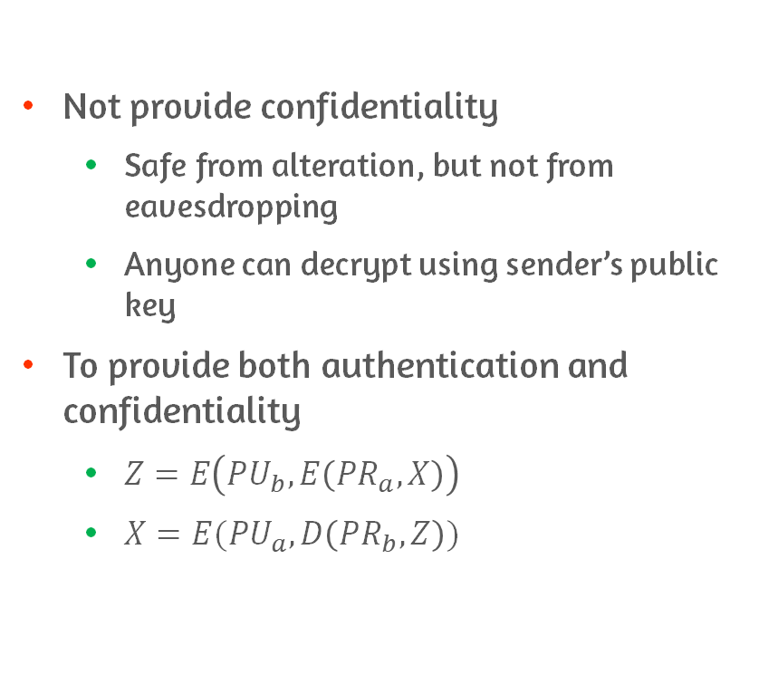
Confidentiality of Public-Key Cryptosystem: Authentication
Not provide confidentiality
Safe from alteration, but not from eavesdropping
Anyone can decrypt using sender’s public key
To provide both authentication and confidentiality
$Z=E\left({PU}_{b}, E\left({PR}_{a}, X\right)\right)$
$X=E({PU}_{a}, D\left({PR}_{b}, Z\right))$
Notes:
보내는 사람이 자기의 private key로 암호화 -> authentication
받는 사람의 public key로 암호화 -> confidentiality
단점은 복잡하다는 것

Slide 10
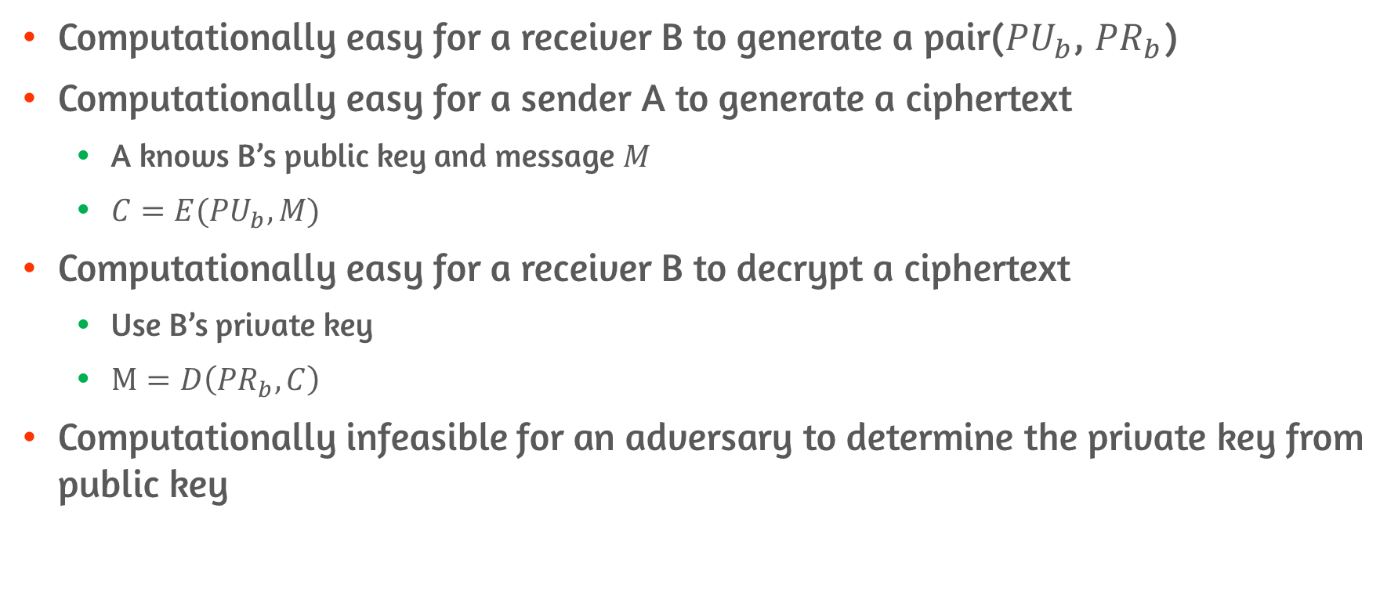
Requirements for Public-Key Cryptography #1
Computationally easy for a receiver B to generate a pair(${PU}_{b}$, ${PR}_{b}$)
Computationally easy for a sender A to generate a ciphertext
A knows B’s public key and message $M$
$C=E({PU}_{b}, M)$
Computationally easy for a receiver B to decrypt a ciphertext
Use B’s private key
$M=D\left({PR}_{b}, C\right)$
Computationally infeasible for an adversary to determine the private key from public key

Slide 11
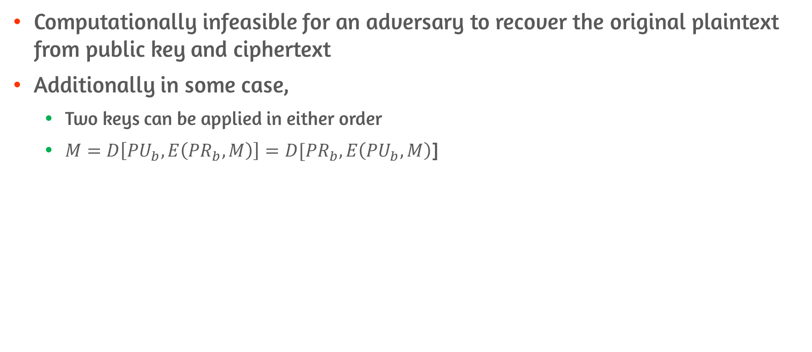
Requirements for Public-Key Cryptography #2
Computationally infeasible for an adversary to recover the original plaintext from public key and ciphertext
Additionally in some case,
Two keys can be applied in either order
$M=D\left[{PU}_{b}, E\left({PR}_{b}, M\right)\right]=D[{PR}_{b}, E\left({PU}_{b}, M\right)$]

Slide 12
Recasting the requirements
Requirements boil down to the need of trap-door one-way function
One-way function
Every function value has a unique inverse
Calculation of the function is easy, but calculation of the inverse is infeasible
Trap-door one-way function
Easy to calculate in one direction and infeasible to calculate in the other direction
Unless certain additional information is known
Notes:
여기서 easy라는 건 T(n) = O(n^k) 즉 n차 다항식으로 풀리는 것을 의미
(n = bit 수)
반대로 infeasible이라는 건 푸는데 걸리는 시간이 n차 다항식 이상으로 증가하는 것
사실 알고리즘의 복잡도를 나타내는 것은 어려움
일반적으로 알고리즘의 성능을 표현할 때, worst case와 average case에 대해 나타내는데,
암호학에서의 알고리즘에서는 모든 input에 대해 infeasible 해야 하기 때문에 기존의 알고리즘 성능 표현 방식이 맞지 않음

Slide 13
Public-Key Cryptanalysis
Brute-force attack
Countermeasure: use a large key
Large key size to make brute-force attack impractical, but small enough for practical encryption and decryption
In practice, too slow
Probable message attack
Plaintext consists of 56-bit DES key
Encrypt all possibility and discover the key

Slide 14
9.2 The RSA algorithm

Slide 15
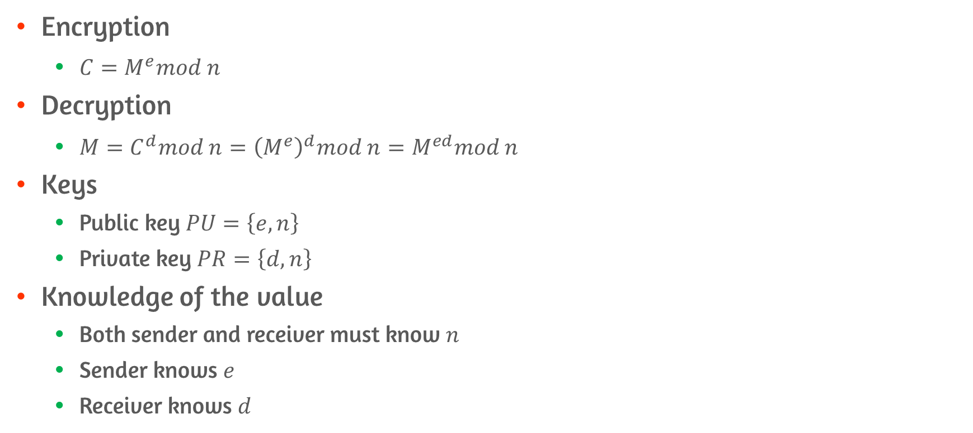
Description of RSA algorithm
Encryption
$C=M^{e}mod n$
Decryption
$M=C^{d}mod n={\left(M^{e}\right)}^{d}mod n=M^{ed}mod n$
Keys
Public key $PU=\left\{e, n\right\}$
Private key $PR=\left\{d, n\right\}$
Knowledge of the value
Both sender and receiver must know $n$
Sender knows $e$
Receiver knows $d$

Slide 16
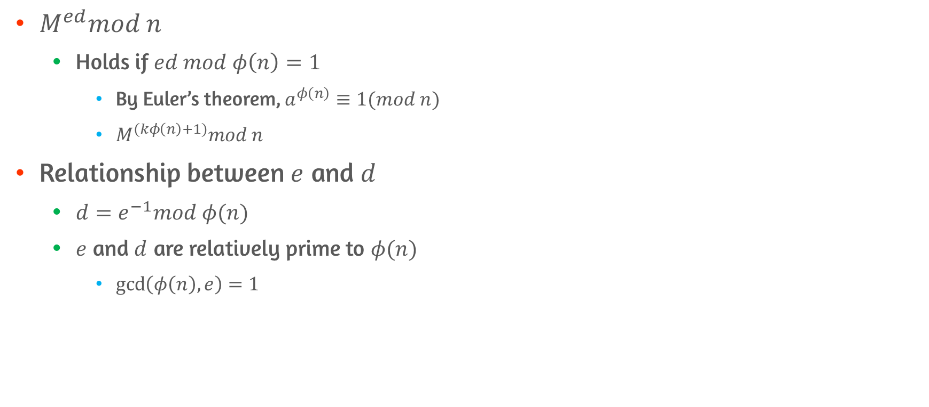

Requirement #1 Finding $e$, $d$, and $n$
$M^{ed}mod n$
Holds if $ed mod φ\left(n\right)=1$
By Euler’s theorem, $a^{φ\left(n\right)}≡1(mod n)$
$M^{(kφ\left(n\right)+1)}mod n$
Relationship between $e$ and $d$
$d=e^{−1}mod φ(n)$
$e$ and $d$ are relatively prime to $φ(n)$
$\gcd\left(φ\left(n\right), e\right)=1$

Slide 17
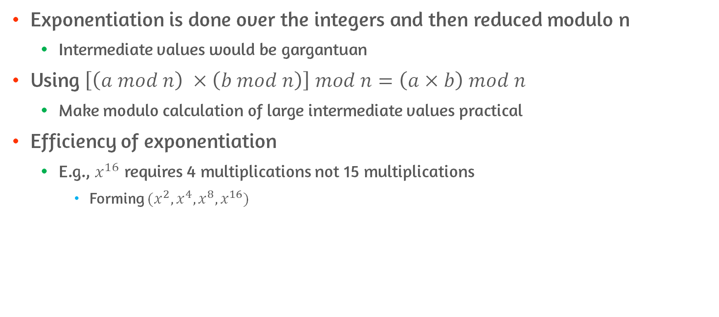
Exponentiation in Modular Arithmetic
Exponentiation is done over the integers and then reduced modulo n
Intermediate values would be gargantuan
Using $\left[\left(a mod n\right) ×\left(b mod n\right)\right] mod n=\left(a×b\right) mod n$
Make modulo calculation of large intermediate values practical
Efficiency of exponentiation
E.g., $x^{16}$ requires 4 multiplications not 15 multiplications
Forming $(x^{2}, x^{4}, x^{8}, x^{16})$

Slide 18
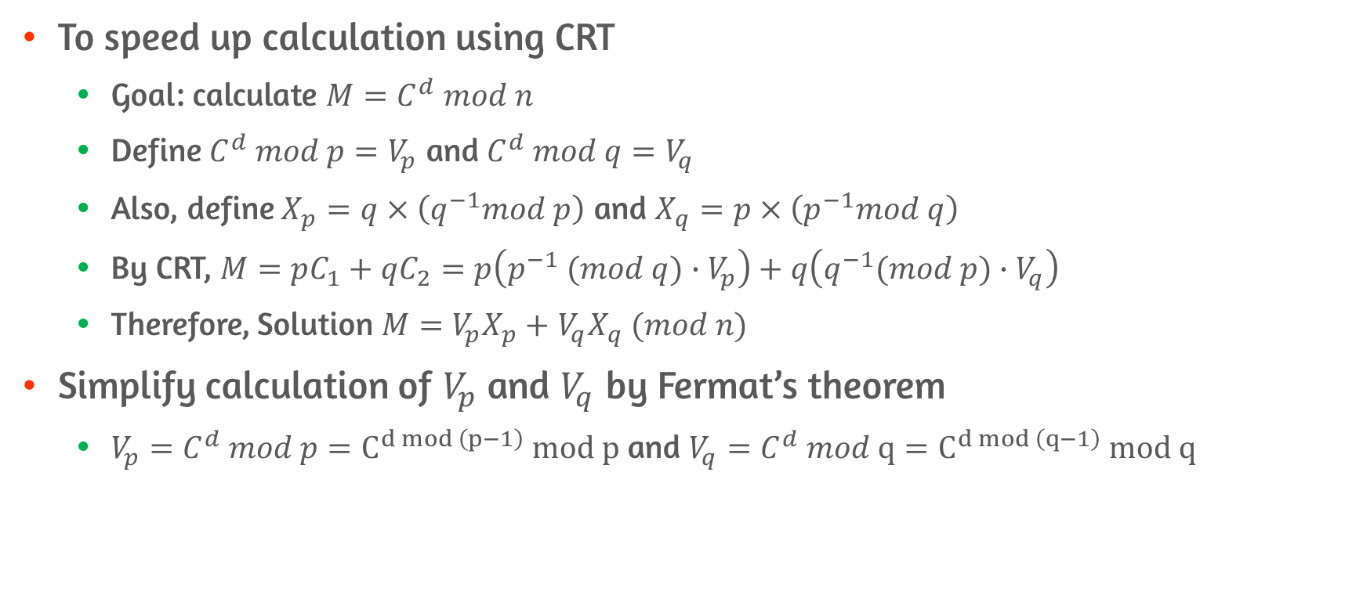
Efficient Operation Using the Private Key
To speed up calculation using CRT
Goal: calculate $M=C^{d} mod n$
Define $C^{d} mod p=V_{p}$ and $C^{d} mod q=V_{q}$
Also, define $X_{p}=q×\left(q^{−1}mod p\right)$ and $X_{q}=p×\left(p^{−1}mod q\right)$
By CRT, $M=pC_{1}+qC_{2}=p\left(p^{−1} (mod q)∙V_{p}\right)+q\left(q^{−1}(mod p)∙V_{q}\right)$
Therefore, Solution $M=$ $V_{p}X_{p}+$ $V_{q}X_{q} (mod n)$
Simplify calculation of $V_{p}$ and $V_{q}$ by Fermat’s theorem
$V_{p}=$ $C^{d} mod p=C^{d mod \left(p−1\right)} mod p$ and $V_{q}=$ $C^{d} mod q=C^{d mod \left(q−1\right)} mod q$

Slide 19
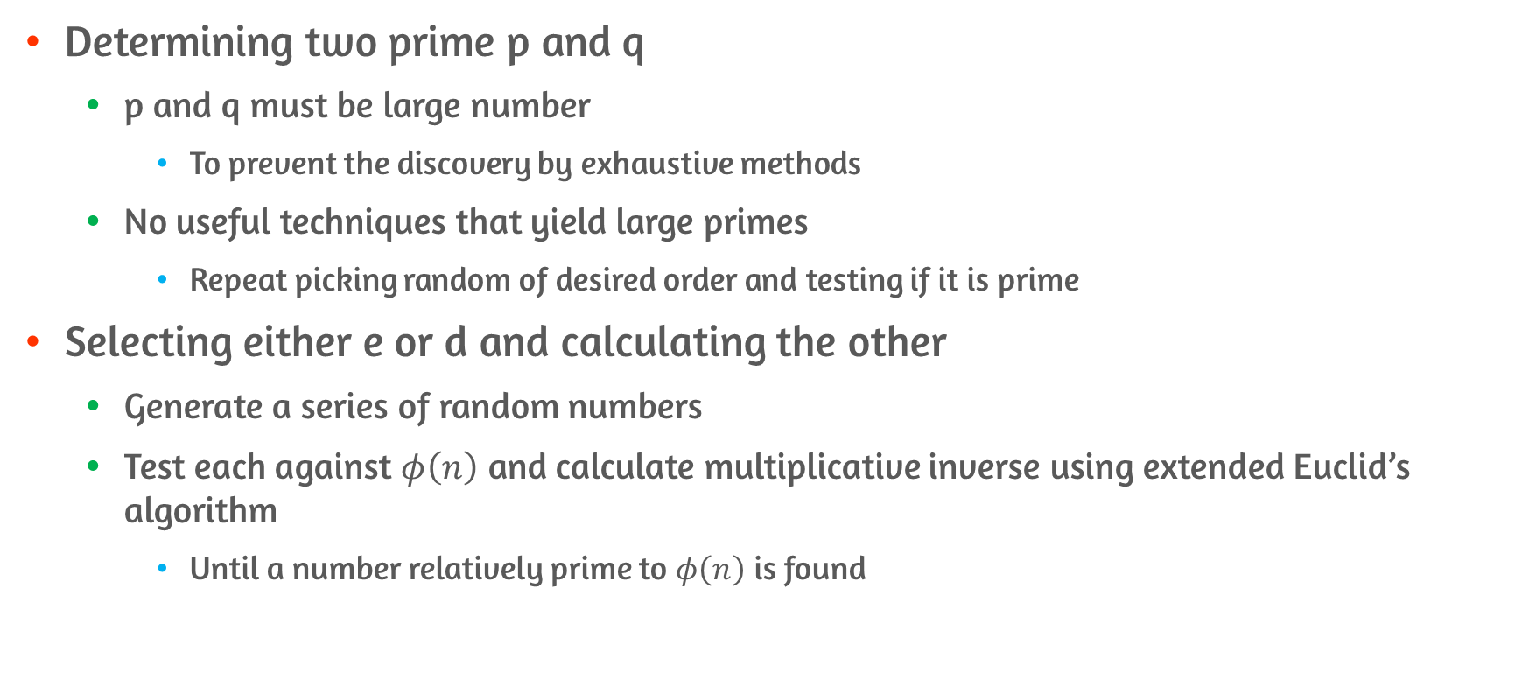
Key Generation
Determining two prime p and q
p and q must be large number
To prevent the discovery by exhaustive methods
No useful techniques that yield large primes
Repeat picking random of desired order and testing if it is prime
Selecting either e or d and calculating the other
Generate a series of random numbers
Test each against $φ\left(n\right)$ and calculate multiplicative inverse using extended Euclid’s algorithm
Until a number relatively prime to $φ\left(n\right)$ is found
Notes:
테스트 결과 해석
Prime이 아니다 = 진짜 아닌 것
Prime이다 = prime일 수도 있고, 아닐 수도 있고,
테스트는 거의 확률적으로 돌아가지만, 확률이 거의 1에 가까움
Tedious procedure이지만 자주 일어나는 일이 아님

Slide 20
5 Approaches to attacking RSA
Brute force: try all possible private keys
Mathematical attacks: factor the product of two primes
Timing attacks: depend on running time of decryption algorithm
Hardware fault-based attack: induce hardware faults in the processor that is generating digital signatures
Chosen ciphertext attacks: exploits properties of the RSA algorithm

Slide 21
Brute-Force Attack
Try all possible keys
Defense is to use a large key space
The larger the size of the key, the slower

Slide 22
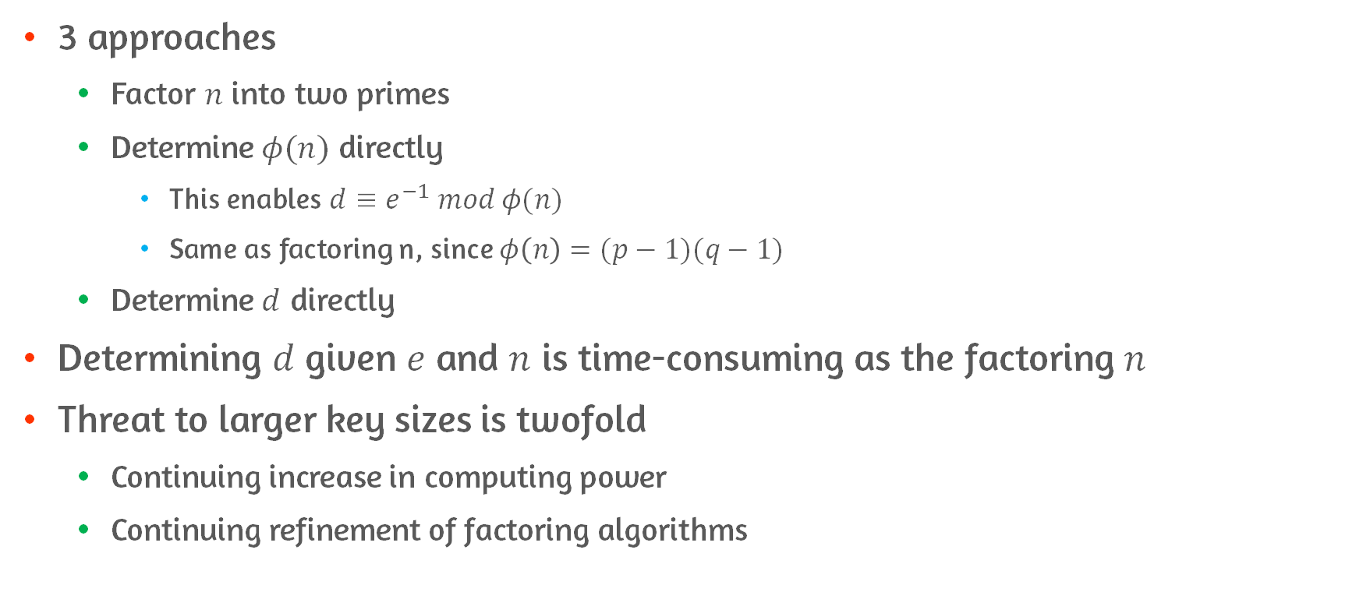
Mathematical Attacks
3 approaches
Factor $n$ into two primes
Determine $φ(n)$ directly
This enables $d≡e^{−1} mod φ(n)$
Same as factoring n, since $φ\left(n\right)=(p−1)(q−1)$
Determine $d$ directly
Determining $d$ given $e$ and $n$ is time-consuming as the factoring $n$
Threat to larger key sizes is twofold
Continuing increase in computing power
Continuing refinement of factoring algorithms

Slide 23
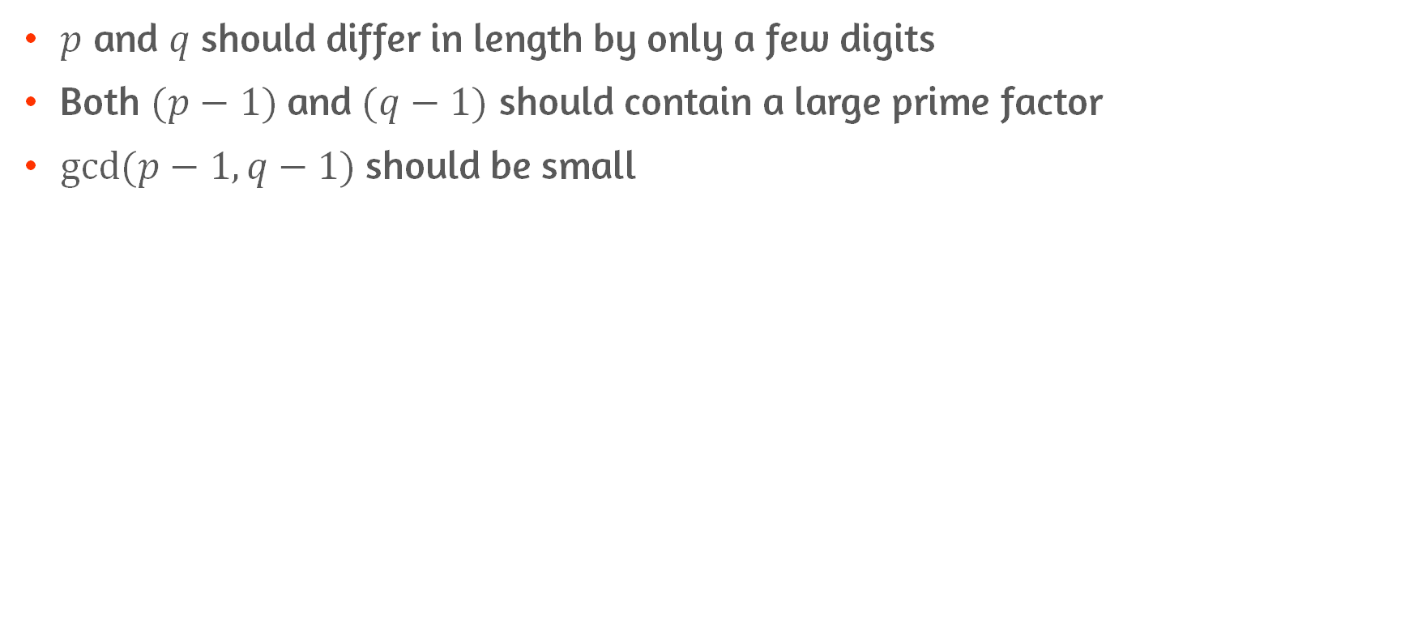
Additional Constraints for Determining Values
$p$ and $q$ should differ in length by only a few digits
Both $(p−1)$and $(q−1)$ should contain a large prime factor
$gcd⁡(p−1, q−1)$should be small

Slide 24
Timing Attacks
Determine a private key by keeping track of how long a computer takes to decipher messages
In practice, no extreme time variation in modular exponentiation
Countermeasures
Constant exponentiation time
Adding a random delay to exponentiation algorithm
Blinding: multiply ciphertext by a random number before performing exponentiation

Slide 25
Fault-Based Attack
Attacks on that is generating RSA digital signatures
Induces faults in the signature computation by reducing the power to the processor
Faults cause the software to produce invalid signatures
attacker can recover the private key
Not a serious threat
Since it requires physical access

Slide 26
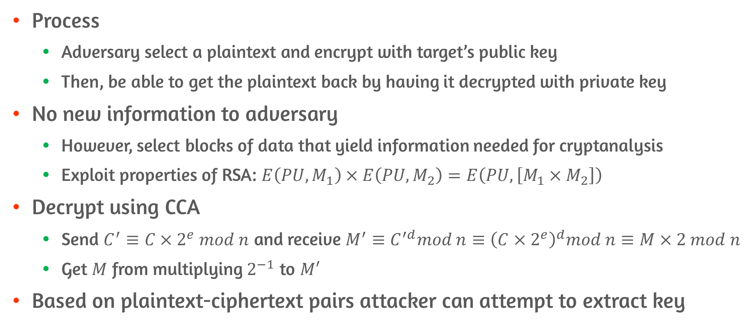
Chosen Ciphertext Attack
Process
Adversary select a plaintext and encrypt with target’s public key
Then, be able to get the plaintext back by having it decrypted with private key
No new information to adversary
However, select blocks of data that yield information needed for cryptanalysis
Exploit properties of RSA: $E\left(PU, M_{1}\right)×E\left(PU, M_{2}\right)=E\left(PU, \left[M_{1}×M_{2}\right]\right)$
Decrypt using CCA
Send $C^{′}≡C×2^{e} mod n$ and receive $M^{′}≡C^{′d}mod n≡{\left(C×2^{e}\right)}^{d}mod n≡M×2 mod n$
Get $M$ from multiplying $2^{−1}$ to $M′$
Based on plaintext-ciphertext pairs attacker can attempt to extract key
Notes:
Decryption 하려는 메시지 C가 있는데, 그걸 바로 보내면 말이 안되니까 변형
C’ = C x 2^e mod n
C’의 decryption 요구
M’ = C’^d mod n = (C x 2^e)^d mod n = C^d x 2^ed mod n = C^d x 2 mod n
그러면 C^d는 받은 복호화 메시지 M’에 2의 역원만 곱하면 된다

Slide 27
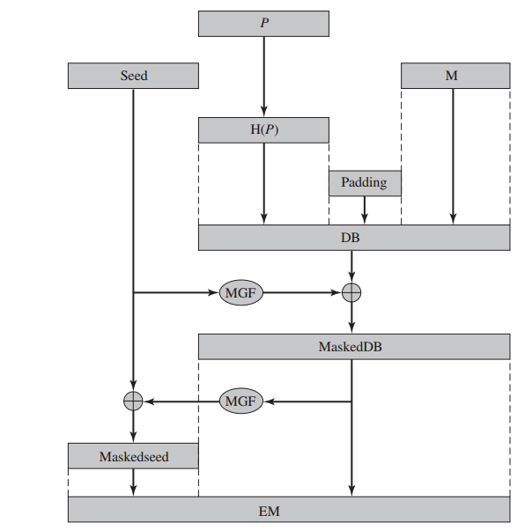
Optimal Asymmetric Encryption Padding(OAEP)
Padding scheme used together with RSA encryption
Use hash functions
Notes:
https://blog.naver.com/PostView.nhn?blogId=ilikebigmac&logNo=221725226361

Slide 28
Conclusion
Principles of public-key cryptosystems
Confidentiality and authentication
The RSA algorithm
Mathematical proof
Efficient calculation
Possible attacks and countermeasures

